Slide 1
UCF439 Capstone Project TOTO: Children-Friendly A.I enabled Tutor device Embedded within a Soft Toy Group No. (G-131)
Supervisor Name:
Mr. Tarun Kumar
Assistant Professor
tarun.kumar@dituniversity.edu.in
Student’s name, SAP IDs :
Mohammad Ehson, 1000015169
Rishab Choudhary, 1000014560
Saket Pandey, 1000014479

Slide 2
Introduction
TOTO is a groundbreaking project aimed at addressing the issue of excessive screen time among children by introducing an Raspberry pi 3 and Chat GPT-based interactive voice-controlled compact robot embedded within a soft toy powered by batteries.
This research endeavor focuses on creating a friendly and engaging educational companion for children, providing features such as GPT responses, educational assistance, custom trainability, weather forecasts, all at minimal costs.
By leveraging the Raspberry pi 3, Chat GPT technology, and cloud services like Google Cloud, TOTO offers a unique solution to enhance learning experiences while minimizing screen dependency.

Slide 3
Introduction
TOTO Applications
Interactive Learning Companion: TOTO can serve as an interactive learning companion for children, providing personalized educational content tailored to their needs and interests. It can engage children in educational activities, such as practicing math problems, learning vocabulary, or exploring scientific concepts through interactive dialogues.
Special Education Support: TOTO can be customized to provide support for children with special education needs. It can offer personalized learning experiences, adapt to individual learning styles, and provide additional assistance for children with learning disabilities or developmental delays.
Language Learning: TOTO can facilitate language learning by engaging children in interactive conversations, practicing pronunciation, and providing real-time feedback. It can support language acquisition in both native and foreign languages, making learning fun and engaging.
STEM Education: TOTO can be integrated into STEM (Science, Technology, Engineering, and Mathematics) education initiatives to enhance hands-on learning experiences. It can facilitate experiments, demonstrations, and exploratory activities in various STEM subjects, fostering curiosity and problem-solving skills in children.

Slide 4
Background Work
[1] The impact of artificial intelligence (AI) activities on young children's perceptions of robots is a growing area of research. Studies investigate how children interact with AI-driven robots, such as educational tools or social companions, and how these interactions shape their attitudes and beliefs.Research in this field aims to provide insights into how early experiences with AI influence children's attitudes toward technology and inform the design of educational interventions and robotics applications for children.
[2] Interactive robots are increasingly being explored as social partners to assist in communication and care for children, particularly those with special needs or communication disorders. These robots are designed to engage children in interactive activities, facilitate communication, and provide emotional support. Research in this area focuses on developing robots with natural language processing capabilities, emotional understanding, and adaptive behaviour to effectively interact with children. By serving as social partners, these robots aim to enhance children's communication skills, emotional well-being, and social interactions
[3] Research on individual and family correlates of imagination in preschool children explores various factors that influence the development of imaginative abilities in early childhood[3]. This field of study investigates how characteristics of both the child and their family environment contribute to the richness and complexity of children's imaginative play and creativity. Factors such as cognitive abilities, temperament, social interactions, parental involvement, family dynamics, and cultural background are examined to understand how they shape children's imaginative capacities. By identifying these correlates, researchers aim to gain insights into the multifaceted nature of imagination in pre schoolers and inform strategies for fostering creative development in early childhood.

Slide 5
Background Work
[4]In recent years, research on Companion Robot has been under heated discussion. The
research scope of companion robots is also quite wide.Using robotic partners to interact with sick children in hospital environments can reduce their pain and thus improve the efficiency of cancer treatment [4].
[5]Billard et al. constructed robots with physical characteristics similar to human babies. It has been used as an assistant technology in behavioral research of autistic children [5]
[6]Michaelis et al. designed learning partner robots to increase reading activity and observe the impact of robots on family reading experience [6].
[7]Cavallo proposed a novel method based on reliability and acceptability assessment. This method is used to design, develop and test a personal robot system consisting of a mobile robot platform and an intelligent environment to assist people at home. The viewpoint that robots need to cooperate closely with human beings, so novel interactive engineering design methods are needed to develop service robots [7] that meet the needs of end users and can be used quickly in daily life.

Slide 6
Feasibility Study
Feasibility Assessment:
Technical Feasibility: The project utilizes readily available technologies such as Raspberry pi 3 microcontroller, Chat GPT, and Google Cloud services, making it technically feasible.The expertise required for development, including programming skills and hardware knowledge, is available within the team or can be acquired through training.
Market Feasibility: The cost of hardware components such as Raspberry pi 3 microcontroller, microphone, and amplifier, along with software licenses for Chat GPT and cloud services, should be considered.The project aims to provide a cost-effective solution by utilizing affordable components and cloud-based services, ensuring economic feasibility.
Operational Feasibility: TOTO is designed to seamlessly integrate into educational environments, providing an intuitive interface for children and easy management for educators.User acceptance testing and feedback sessions can be conducted to ensure that TOTO meets the operational requirements of its intended users.
Cost Analysis: The project timeline should include development, testing, and deployment phases, with milestones to track progress.Adequate resources and personnel should be allocated to ensure timely completion of each phase.

Slide 7
Project Description
Topic : TOTO: Children-Friendly A.I enabled Tutor device Embedded within a Soft Toy
Objectives: The objective of the TOTO project is to develop a children-friendly tutor robot uniquely embedded within a soft toy, leveraging cutting-edge technologies like the Raspberry pi 3 microcontroller and Chat GPT.
Importance: TOTO aims to revolutionize childhood education and development by providing an interactive and engaging learning experience for children. It serves as an educational companion, offering personalized content, mitigating excessive screen time, and enhancing cognitive development. Through innovative technology integration, TOTO aims to redefine the way children learn and interact with educational content.

Slide 8
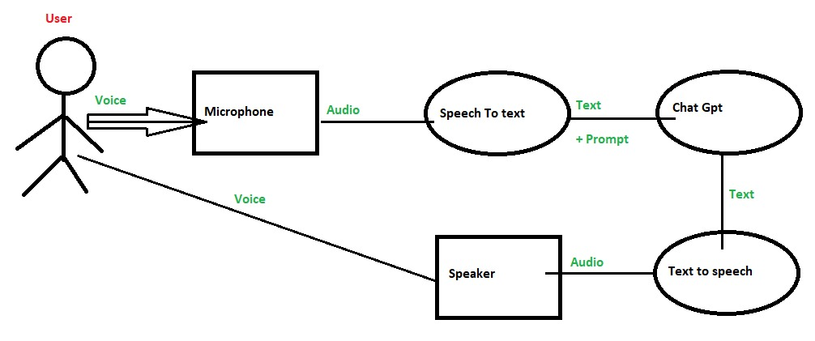
Project Description

Slide 9
Project Description
Key features
Voice Control Interface: With its intuitive voice control interface, TOTO enables seamless interaction between children and the educational content, enhancing user engagement.
Custom promted Chat GPT: TOTO utilizes a custom-promted Chat GPT model specifically designed for children, ensuring appropriate and engaging responses tailored to their age group.
Cost-Effective Design: Designed with cost-effective components and cloud
Interactive Learning Companion: TOTO serves as an interactive educational companion, engaging children in educational activities and providing personalized learning experiences.
Educational Content: TOTO offers a wide range of educational content, including math problems, vocabulary exercises, and scientific concepts, delivered through interactive dialogues and activities.

Slide 10
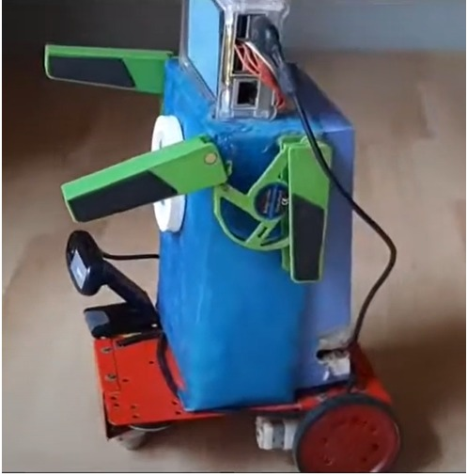
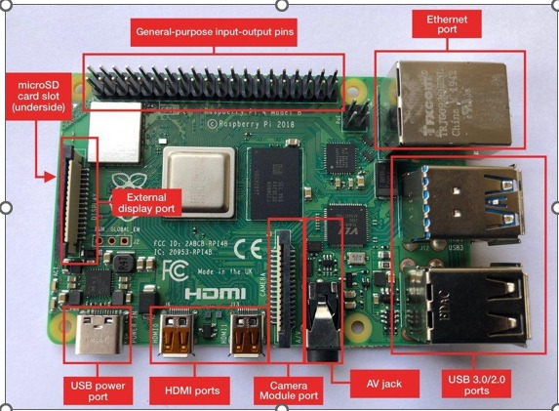
Project Description

Slide 11
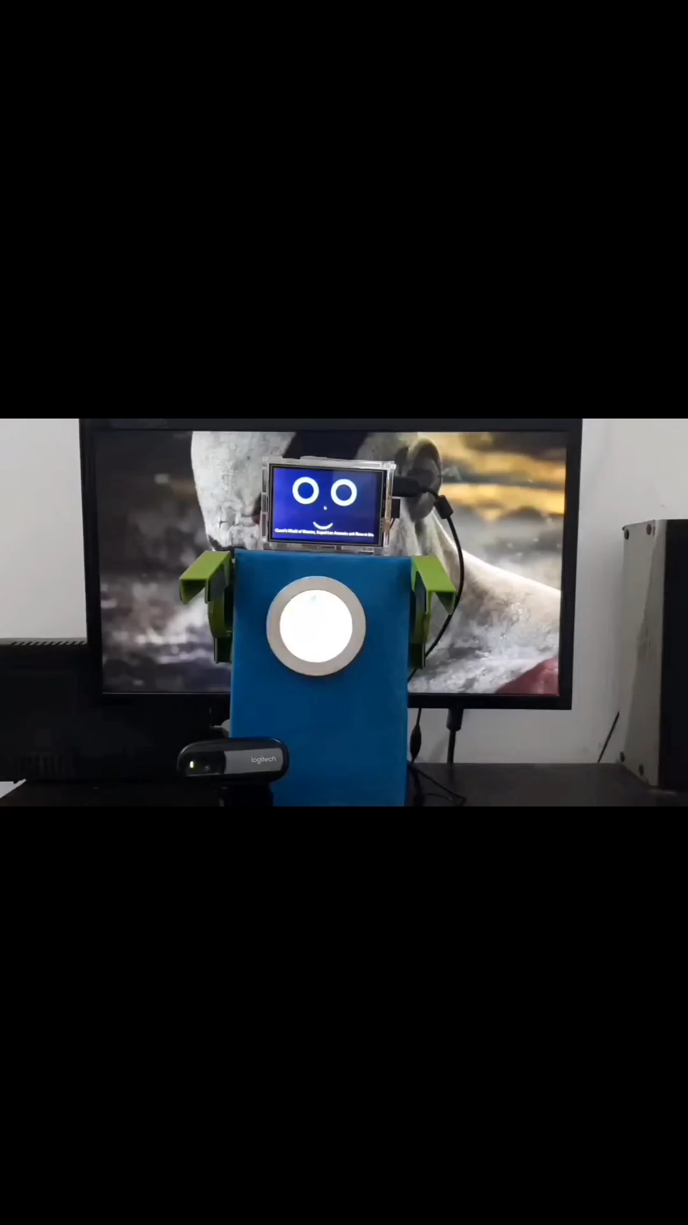
Project Description

Slide 12
Project Timeline
End term Presentation
(May)
Research Paper
Writing
(Apr18-Apr25)
Mid Term Presentation
(Apr1-Apr4)
Finalization of hardware and API choices.
(Feb25-Mar11)
Research Paper
Completion
(Apr26-Apr30)
Implementation
(Apr18-Apr25)
Proposal Form
(Feb7-Feb9)
Literature Review
(Mar12-Mar20)
Reading, Topic Interpretation
(Feb11-Feb24)

Slide 13
REFERENCES
Randi Williams,Hae Won Park ,Cynthia Breazeal:The Impact of Artificial Intelligence Activities on Young Children's Perceptions of Robots.CHI '19: Proceedings of the 2019 CHI Conference on Human Factors in Computing Systems. 447, 1–11 (2019) https://doi.org/10.1145/3290605.3300677
Lili Liu, Bingbing Li, I-Ming Chen, Fellow, IEEE, Tze Jui Goh, Min Sung. Interactive robots as social partner for communication care link
Manosevitz, M., Prentice, N. M., & Wilson, F. (1973). Individual and family correlates of imaginary companions in preschool children. Developmental Psychology, 8(1), 72–79. https://doi.org/10.1037/h0033834
Amitai Etzioni.Robotic Care of Children, the Elderly, and the Sick (with Oren Etzioni).Happiness is the Wrong Metric pp 265–277 https://link.springer.com/chapter/10.1007/978-3-319-69623-2_17
Billard, A., et al.: Building Robota, a mini-humanoid robot for the rehabilitation of children with autism. Assist. Technol. 1(19), 37–49 (2017) https://pubmed.ncbi.nlm.nih.gov/17461289/
Michaelis, J.E., Mutlu, B.: Reading socially: transforming the in-home reading experience with a learning-companion robot. Sci. Robot. 21(3), P2 (2018) https://doi.org/10.1126/scirobotics.aat5999
Cavallo, F., et al.: Design impact of acceptability and dependability in assisted living robotic applications. Int. J. Interact. Des. Manuf. – IJIDEM 4(12), 1167–1178 (2018) link

